Slide 1
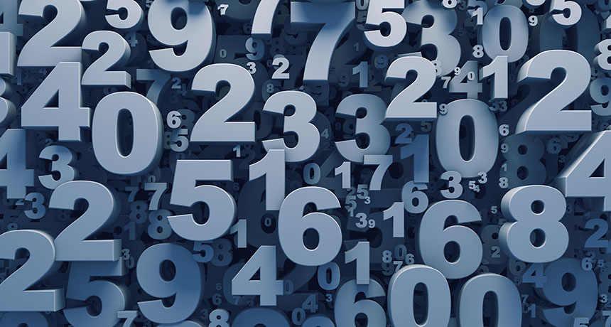
NUMBERS
AFANDI INDIATSI
MICHELLE OMONDI

Slide 2
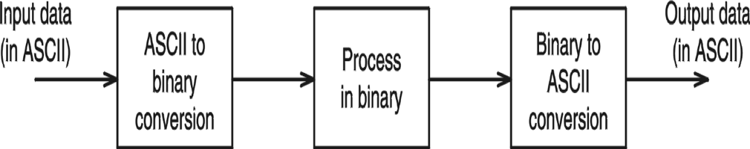
Representation of Numbers
Numbers are in ASCII form; when received from the keyboard and when sending to the display.
Binary form is efficient to process numbers internally.
Conversion is required between these two number representations.

Slide 3
ASCII Representation
A number using ASCII representation stores a single ASCII digit in each byte.
For example; 5,678 is stored as the following sequence of hexadecimal bytes:
35 | 36 | 37 | 38 | 39

Slide 4
ASCII Adjust After Addition(AAA) Instruction
Adjusts the binary result of an ADD or ADC instruction. It makes the result in AL consistent with ASCII decimal representation. The carry value if any, ends up in AH.
sub AH,AH ; clear AH
mov AL,’6’ ; AL := 36H
add AL,'7’ ; AL := 36H+37H = 6DH
aaa ; AX := 0103H
or AL,30H ; AL := 33H

Slide 5
ASCII Adjust After Subtraction(AAS) Instruction
Adjusts the binary result of an SUB or SBB instruction. It makes the result in AL consistent with ASCII decimal representation. The carry value if any, ends up in AH. In all cases, the most significant four bits in AL are cleared. This adjustment is needed only if the result is negative.
sub AH,AH ; clear AH
mov AL,’9’ ; AL := 39H
add AL,’3’ ; AL := 39H-33H = 36H
sub ; AX := 0006H
or AL,30H ; AL := 36H
Notes:
SBB (subtract with borrow) instruction subtracts both a source operand and the value of the Carry flag from a destination operand.

Slide 6
ASCII Adjust After Multiplication(AAM) Instruction
Adjusts the binary result of a MUL instruction. The multiplication must have been performed on unpacked BCD numbers.
AL is divided by 10, quotient is stored in AH and remainder in AL
mov AL,3 ; multiplier in unpacked BCD form
mov BL,9 ; multiplicand in unpacked BCD form
mul BL ; result 001BH is in AX
aam ; AX := 0207H
or AX,3030H ; AX := 3237H

Slide 7
ASCII Adjust After Division(AAD) Instruction
Adjusts the unpacked BCD dividend in AX before a division operation. The denominator is a single unpacked byte
Multiplies AH by 10 and adds it to AL and sets AH to 0
aad instruction reverses the changes done by aam
mov AX,0207H ; dividend in unpacked BCD form
mov BL,05H ; divisor in unpacked BCD form
aad ; AX := 001BH
div BL ; AX := 0205H

Slide 8
Binary Coded Decimal
Binary-coded decimal (BCD) integers use 4 binary bits to represent each decimal digit.
A number using unpacked BCD representation stores a decimal digit in the lower four bits of each byte.
For example; 5,678 is stored as the following sequence of hexadecimal bytes:
05 | 06 | 07 | 08

Slide 9
Packed Decimal Arithmetic
Store two decimal integers per byte.
For example; 12,345,678 can be stored as the following sequence of hexadecimal bytes:
12 | 34 | 56 | 78

Slide 10
Decimal Adjust After Addition (DAA) Instruction
Converts the binary result of an ADD or ADC operation to packed decimal format.
mov AL,71H
add AL,43H ; AL := B4H
daa ; AL := 14H and CF := 1

Slide 11
Decimal Adjust After Subtraction (DAS) Instruction
Converts the binary result of a SUB or SBB operation to packed decimal format.
mov al,48h
sub al,35h ; AL = 13h
das ; AL = 13h CF = 0

Slide 12
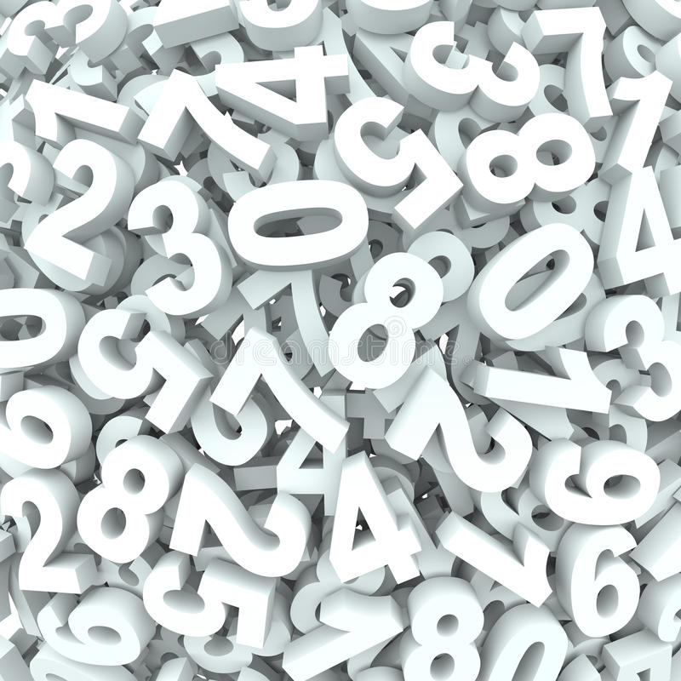
Thank you
It’s a beautiful day to save lives ☺

